Slide 1
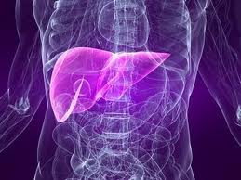
Data Mining Approach to determine Liver Patients
Course : CS 513
Department : Computer Science
Prepared by : Shraddha Khule
Student Id : 10371285
Guided by : Prof. Mahmoud Daneshmand

Slide 2

Introduction
Patients suffering from Liver
disease have been continuously
increasing because of excessive
consumption of alcohol, inhale of
harmful gases, intake of contaminated food and drugs.
Problems with liver patients are not easily discovered in an early stage, as the liver will be functioning normally even when it is partially damaged.
Liver disease can be diagnosed by analyzing the levels of enzymes in the blood.
An early diagnosis of liver problems will help to increase the patient’s survival rate.

Slide 3
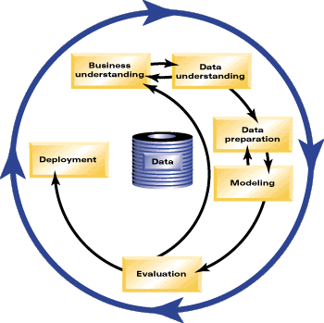
Standard Process: CRISP-DM
We will use the CRISP-DM to understand the underlying problem and to solve it.
CRISP-DM(Cross Industry Standard Process for Data Mining) has 6 phases.
  Business Understanding
    What is the data mining project we are trying to accomplish?
  Data Understanding
    What data can we use?
    Where is the data?
    Familiarize with the data.
  Data Preparation
  Perform Transformation on data.
    Clean data from missing values and outliers.
    Select specific data for analysis.

Slide 4
Standard Process: CRISP-DM
  4. Modeling
    Select appropriate data modeling technique.
    Optimize model.
    Define alternative models for project.
  Evaluation
  Evaluate the model.
  Determine success rate of model.
  Does model meet project objectives?
  6. Deployment
  Use the model for production data.
  Generate statistics report on data to ensure success.
  Provide business with the deployment instructions for the model so that it can be reused.

Slide 5

Business Understanding
What is the Profound Question?
Determine if a patient is suffering from a
Liver disease?
Goal:
Use data mining techniques like Classification Algorithms, to classify patients as liver patients and non liver patients and derive rules for the same.
What will be the Accomplishments?
The derived rules will ease the doctor’s job in identifying patients suffering from liver disease.
Moreover the derived rules will help in early diagnosis of liver problems which will in turn increase the patient’s survival rate.

Slide 6

Data Understanding
Data Source:
The data set belongs to the data collected
for a recent research study conducted in
2011-2012 for Liver Diagnosis.
The study was conducted by Prof Bendi Venkata Ramana, Prof. M.Surendra Prasad Babu and Prof. N. B. Venkateswarlu.
The purpose of the study was to classify patients as liver patients and non liver patients by applying Data Mining techniques, which can then be used in the future to diagnose liver patients at an early stage and thus increase their chances of survival.
The data was obtained from www.kdnuggets.com

Slide 7
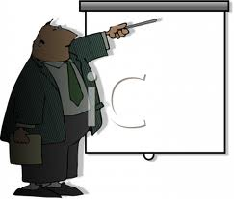
Data Understanding
Data set details:
The data set contains 416 liver patient
records and 167 non liver patient
records i.e. a total of 583 patient records.
The data set has a total of 11 attributes. Out of which 10 are Independent attributes and 1 is the Target attribute.
The Target attribute is the one that classifies the patients as liver patients and non liver patients.

Slide 8
Data Understanding
Data set Sample:
Age | Gender$ | TB | DB | Alkphos | Sgpt | Sgot | TP | ALB | AGratio | Target
65 | Female | 0.7 | 0.1 | 187 | 16 | 18 | 6.8 | 3.3 | 0.9 | 1
62 | Male | 10.9 | 5.5 | 699 | 64 | 100 | 7.5 | 3.2 | 0.74 | 1
62 | Male | 7.3 | 4.1 | 490 | 60 | 68 | 7 | 3.3 | 0.89 | 1
58 | Male | 1 | 0.4 | 182 | 14 | 20 | 6.8 | 3.4 | 1 | 1
72 | Male | 3.9 | 2 | 195 | 27 | 59 | 7.3 | 2.4 | 0.4 | 1
46 | Male | 1.8 | 0.7 | 208 | 19 | 14 | 7.6 | 4.4 | 1.3 | 1
26 | Female | 0.9 | 0.2 | 154 | 16 | 12 | 7 | 3.5 | 1 | 1
29 | Female | 0.9 | 0.3 | 202 | 14 | 11 | 6.7 | 3.6 | 1.1 | 1
17 | Male | 0.9 | 0.3 | 202 | 22 | 19 | 7.4 | 4.1 | 1.2 | 2
55 | Male | 0.7 | 0.2 | 290 | 53 | 58 | 6.8 | 3.4 | 1 | 1
57 | Male | 0.6 | 0.1 | 210 | 51 | 59 | 5.9 | 2.7 | 0.8 | 1
72 | Male | 2.7 | 1.3 | 260 | 31 | 56 | 7.4 | 3 | 0.6 | 1
64 | Male | 0.9 | 0.3 | 310 | 61 | 58 | 7 | 3.4 | 0.9 | 2
74 | Female | 1.1 | 0.4 | 214 | 22 | 30 | 8.1 | 4.1 | 1 | 1
61 | Male | 0.7 | 0.2 | 145 | 53 | 41 | 5.8 | 2.7 | 0.87 | 1
25 | Male | 0.6 | 0.1 | 183 | 91 | 53 | 5.5 | 2.3 | 0.7 | 2
38 | Male | 1.8 | 0.8 | 342 | 168 | 441 | 7.6 | 4.4 | 1.3 | 1
33 | Male | 1.6 | 0.5 | 165 | 15 | 23 | 7.3 | 3.5 | 0.92 | 2
40 | Female | 0.9 | 0.3 | 293 | 232 | 245 | 6.8 | 3.1 | 0.8 | 1
40 | Female | 0.9 | 0.3 | 293 | 232 | 245 | 6.8 | 3.1 | 0.8 | 1
51 | Male | 2.2 | 1 | 610 | 17 | 28 | 7.3 | 2.6 | 0.55 | 1
51 | Male | 2.9 | 1.3 | 482 | 22 | 34 | 7 | 2.4 | 0.5 | 1
62 | Male | 6.8 | 3 | 542 | 116 | 66 | 6.4 | 3.1 | 0.9 | 1
40 | Male | 1.9 | 1 | 231 | 16 | 55 | 4.3 | 1.6 | 0.6 | 1
63 | Male | 0.9 | 0.2 | 194 | 52 | 45 | 6 | 3.9 | 1.85 | 2
34 | Male | 4.1 | 2 | 289 | 875 | 731 | 5 | 2.7 | 1.1 | 1
34 | Male | 4.1 | 2 | 289 | 875 | 731 | 5 | 2.7 | 1.1 | 1
34 | Male | 6.2 | 3 | 240 | 1680 | 850 | 7.2 | 4 | 1.2 | 1
20 | Male | 1.1 | 0.5 | 128 | 20 | 30 | 3.9 | 1.9 |  | 2

Slide 9

Data Understanding
Attribute details:
Age : Age of the patient
continuous variable
2. Gender : Gender of the patient
discrete variable ( values : male , female)
3. TB : Total Bilirubin
continuous variable
4. DB : Direct Bilirubin
continuous variable
5. Alkphos : Alkaline Phosphotase
continuous variable

Slide 10
Data Understanding
6. Sgpt : Alamine Aminotransferase
continuous variable
Sgot : Aspartate Aminotransferase
continuous variable
TP : Total Protiens
continuous variable
9. ALB : Albumin
continuous variable
AGratio : Albumin and Globulin Ratio
continuous variable
Target : Selector field used to classify the data into two sets.
discrete variable(1- indicates liver patient, 2-indicates non liver patients)

Slide 11

Data Preparation
For data preparation the data set will be
cleansed and transformed. The data set
is reviewed for the following :
Handle Missing values and Outliers if any.
Look for attributes that might need transformation.
Select attributes appropriate for analysis.

Slide 12
Data Preparation
Handling Missing values:
The data set has few missing values for the attribute AGratio, as highlighted in figure below.
Age | Gender | TB | DB | Alkphos | Sgpt | Sgot | TP | ALB | AGratio | Target
51 | Male | 0.8 | 0.2 | 230 | 24 | 46 | 6.5 | 3.1 |  | 1
35 | Female | 0.6 | 0.2 | 180 | 12 | 15 | 5.2 | 2.7 |  | 2
38 | Female | 0.7 | 0.1 | 152 | 90 | 21 | 7.1 | 4.2 | 1.4 | 2
The attribute AGratio is a numeric field. So we will replace the missing values with the Mean of the non missing values for this attribute.
The Mean for attribute AGratio is 0.95. All the missing values for this attribute will be replaced by 0.95
Age | Gender | TB | DB | Alkphos | Sgpt | Sgot | TP | ALB | AGratio | Target
51 | Male | 0.8 | 0.2 | 230 | 24 | 46 | 6.5 | 3.1 | 0.95 | 1
35 | Female | 0.6 | 0.2 | 180 | 12 | 15 | 5.2 | 2.7 | 0.95 | 2
38 | Female | 0.7 | 0.1 | 152 | 90 | 21 | 7.1 | 4.2 | 1.4 | 2

Slide 13

Data Preparation
Identifying Outliers:
No outliers were found in the given data set.
Selecting relevant attributes for analysis:
The data set consists of 10 independent attributes namely Age, Gender, TB, DB, Alkphos, Sgpt, Sgot, TP, ALB and AGratio.
All the above 10 attributes seem to be equally important in determining the dependent attribute : Target (which classifies the patients as liver patients or not liver patients).
So all the above 10 attributes will form part of the data set that we will use for analysis.

Slide 14

Data Preparation
Data division:
The previously shown data set
consisting of 583 records is divided into 2 sets.
Training data set is used to develop the model. 80% of the data is used in this set i.e.465 records are used.
Testing data used to evaluate the model developed using the Training data set. 20% data is used in this set i.e. the remaining 118 records are used in this set.

Slide 15

Modeling
The next step is to select the appropriate
Modeling technique.
We will use one of the Machine Learning
Algorithms for our case.
Why Machine Learning Algorithms?
ML derives rules from data.
It takes the selected data and finds the relationship between dependent and independent variables.
Using ML the relationship can be described as a decision tree, a rule, a chart, or an equation.
ML Algorithms answer the question: “What is the pattern that matches this data?”

Slide 16

Modeling
Which ML Technique?
The main objective here is to classify
the patients into liver patients and non-liver patients and derive rules for the same.
So the approach of Recursive Partitioning best fits here, since it splits the data into finer and finer subsets(recursively) resulting in a decision tree.
Also since the target variable is categorical (1- liver patient/2- not liver patient) and is not continuous, Classification Trees is the right choice.
Hence the CART Algorithm seems to be appropriate choice for this problem. CART recursively partitions the data into subsets with similar value of target variable.

Slide 17

Modeling
Which Software Tool ?
CART® software is a robust,
easy-to-use decision tree tool
that automatically sifts large,
complex databases, searching
for and isolating significant patterns and relationships.
CART® can quickly reveal important data relationships that could remain hidden using other analytical tools.
Salford Systems offers a fully functional evaluation version of the CART® software with a free 30 day evaluation unlock code.
I will use the CART® software provided by Salford Predictive Miner.
Site reference: www.salford-systems.com

Slide 18
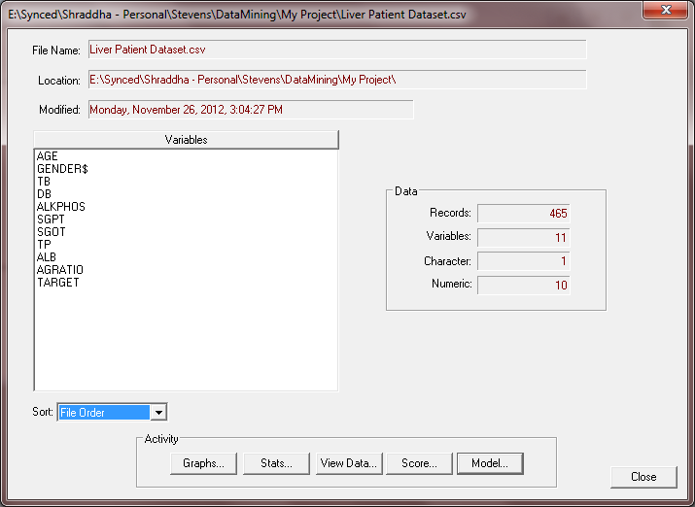
Modeling : Execution using CART®
Selecting the file containing the Training Data Set to generate the Model.

Slide 19
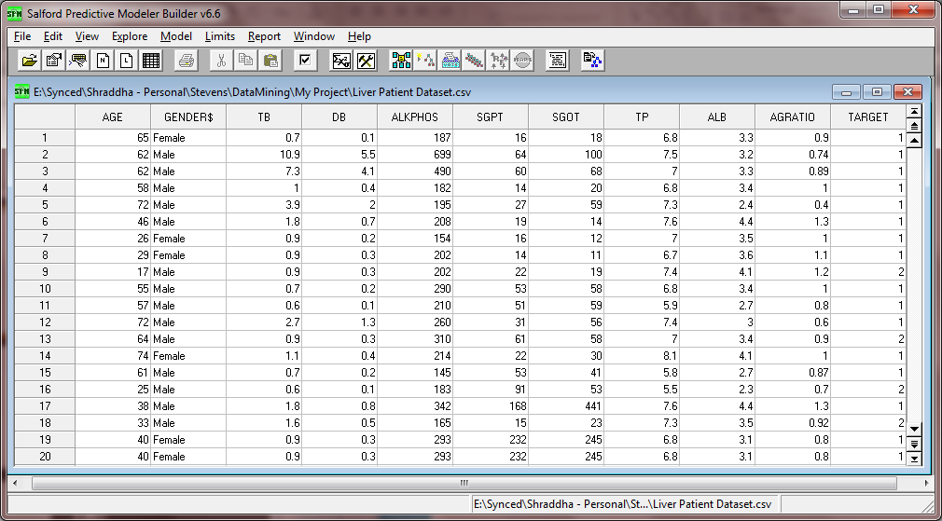
Modeling : Execution using CART®
Viewing the Training Data file

Slide 20
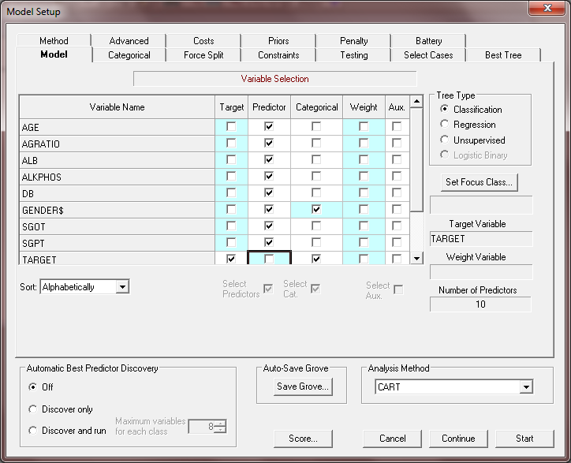
Modeling : Execution using CART®
Setting up the Model
Selecting the Target variable and the Predictor variables.
After the Model is set we can begin the CART analysis by clicking on Start. This will generate the Decision Tree.

Slide 21
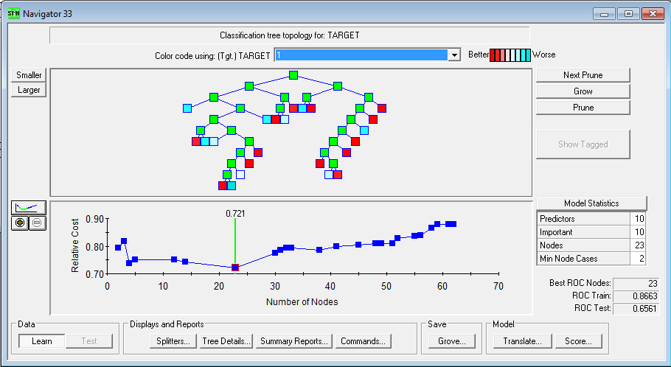
Modeling : Execution using CART®
Classification Tree Topology for TARGET variable.
This is the view of the optimal tree which has the best performance. Number of nodes in the tree equal to 23.
Trees with node sizes 2 up to 62 are available here. Their performance is displayed in the lower panel of the navigator.

Slide 22
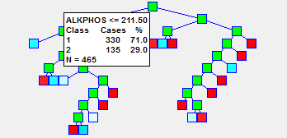
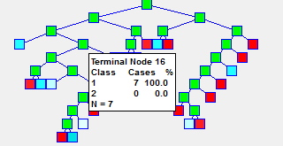
Modeling
Viewing Node details
Figure on the left represents the details of the Root Node.
Viewing the details, we note that we started with 330 liver patients (1s) and 135 non liver patients (0s), for a liver patients rate of 71 %.
And the first split occurred for attribute ALKPHOS.
Figure on right represents the details of one of the terminal nodes, Terminal Node 16.
This node has a liver patient rate of 100% which indicates it’s a pure node, and has a node population of 7.

Slide 23
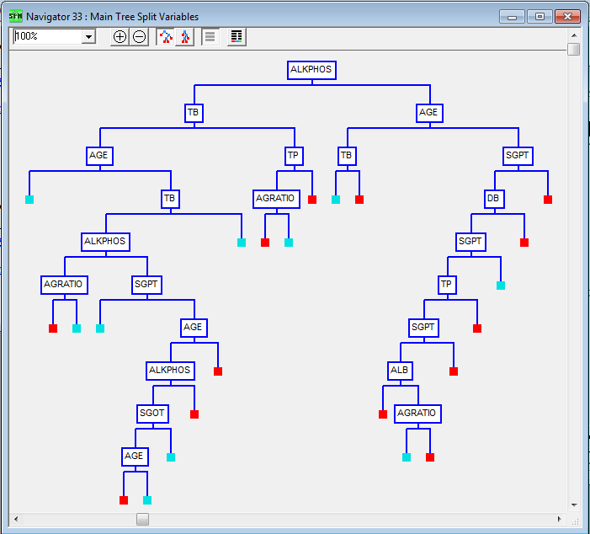
Modeling
Viewing the Main Splitters
This view highlights the attributes that were used at each level for splitting.
Color coding here is simplified with red indicating liver patients and blue indicating non liver patients.

Slide 24
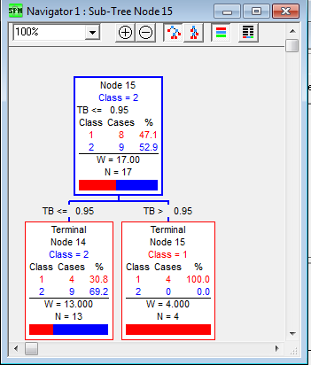
Modeling
Exploring Sub Trees
Figure below represents sub tree for Node 15. As we see the split for this node occurs on attribute TB which finally result in 2 terminal nodes, Terminal node 14 consisting of non liver patients and Terminal node 15 which holds liver patients.

Slide 25
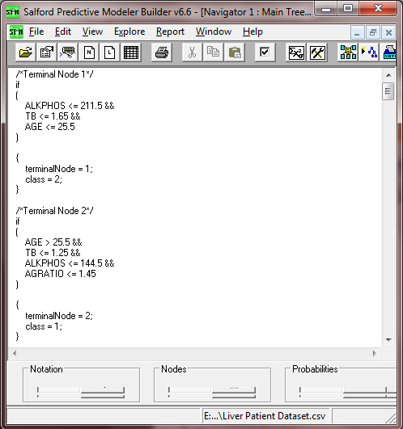
Modeling
Decision Rules derived for the generated Tree.

Slide 26

Modeling
Complete set of Decision Rules.
Antecedent | Consequent
ALKPHOS <= 211.5 && TB <= 1.65 && AGE <= 25.5 | Non liver patient
AGE > 25.5 && TB <= 1.25 && ALKPHOS <= 144.5 && AGRATIO <= 1.45 | Liver patient
AGE > 25.5 && TB <= 1.25 && ALKPHOS <= 144.5 && AGRATIO > 1.45 | Non liver patient
AGE > 25.5 && TB <= 1.25 && ALKPHOS > 144.5 && ALKPHOS <= 211.5 && SGPT <= 19.5 | Non liver patient
TB <= 1.25 && SGPT > 19.5 && ALKPHOS > 144.5 && ALKPHOS <= 203.5 && SGOT <= 17.5 && AGE > 25.5 && AGE <= 57.5 | Liver patient
TB <= 1.25 && SGPT > 19.5 && ALKPHOS > 144.5 && ALKPHOS <= 203.5 && SGOT <= 17.5 && AGE > 57.5 && AGE <= 70.5 | Non liver patient
TB <= 1.25 && SGPT > 19.5 && AGE > 25.5 && AGE <= 70.5 && ALKPHOS > 144.5 && ALKPHOS <= 203.5 && SGOT > 17.5 | Non liver patient
TB <= 1.25 && SGPT > 19.5 && AGE > 25.5 && AGE <= 70.5 && ALKPHOS > 203.5 && ALKPHOS <= 211.5 | Liver patient
TB <= 1.25 && ALKPHOS > 144.5 && ALKPHOS <= 211.5 && SGPT > 19.5 && AGE > 70.5 | Liver patient
ALKPHOS <= 211.5 && AGE > 25.5 && TB > 1.25 && TB <= 1.65 | Non liver patient
ALKPHOS <= 211.5 && TB > 1.65 && TP <= 5.95 && AGRATIO <= 0.54 | Liver patient

Slide 27
Modeling
Decision Rules contd.
Antecedent | Consequent
ALKPHOS <= 211.5 && TB > 1.65 && TP <= 5.95 && AGRATIO > 0.54 | Non liver patient
ALKPHOS <= 211.5 && TB > 1.65 && TP > 5.95 | Liver patient
ALKPHOS > 211.5 && AGE <= 17.5 && TB <= 0.95 | Non liver patient
ALKPHOS > 211.5 && AGE <= 17.5 && TB > 0.95 | Liver patient
ALKPHOS > 211.5 && AGE > 17.5 && DB <= 1.25 && TP <= 7.05 && SGPT <= 49 && ALB <= 2.05 | Liver patient
ALKPHOS > 211.5 && AGE > 17.5 && DB <= 1.25 && TP <= 7.05 && SGPT <= 49 && ALB > 2.05 && AGRATIO <= 0.925 | Non liver patient
ALKPHOS > 211.5 && AGE > 17.5 && DB <= 1.25 && TP <= 7.05 && SGPT <= 49 && ALB > 2.05 && AGRATIO > 0.925 | Liver patient
ALKPHOS > 211.5 && AGE > 17.5 && DB <= 1.25 && TP <= 7.05 && SGPT > 49 && SGPT <= 56.5 | Liver patient
ALKPHOS > 211.5 && AGE > 17.5 && DB <= 1.25 && SGPT <= 56.5 && TP > 7.05 | Liver patient
ALKPHOS > 211.5 && AGE > 17.5 && DB <= 1.25 && SGPT > 56.5 && SGPT <= 61.5 | Non liver patient
ALKPHOS > 211.5 && AGE > 17.5 && SGPT <= 61.5 && DB > 1.25 | Liver patient
ALKPHOS > 211.5 && AGE > 17.5 && SGPT > 61.5 | Liver patient

Slide 28
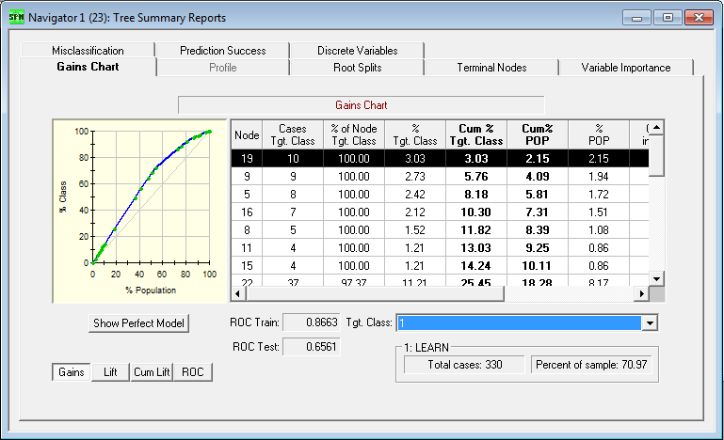
Evaluation
Evaluating the Model : Gains Chart
The Gains curve is simple to read, for instance below curve tells if we look at top 20% of the data we would capture almost 25% of the liver patients( indicated by 1s).

Slide 29
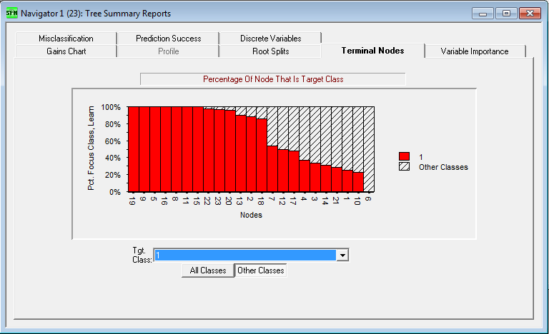
Evaluation
Terminal Nodes Report
This report shows the ability of the Tree’s Terminal nodes to capture the Liver patients.

Slide 30
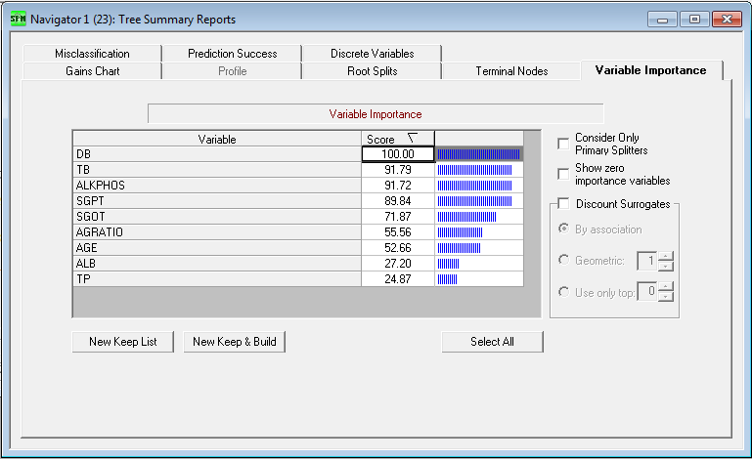
Evaluation
Variable Importance

Slide 31
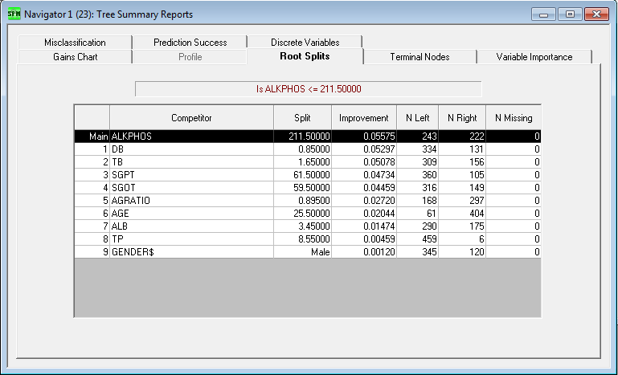
Evaluation
Root Splits
The Root Splits list all root node competitors sorted in descending order.
It also displays split details in terms of case count.

Slide 32
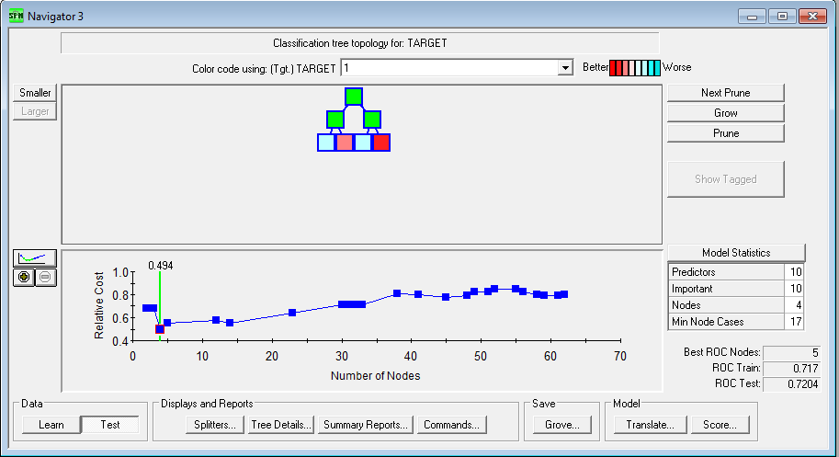
Evaluation
Testing the Model on the Test Data
The figure below shows the performance of the Model on the Test data set.
It shows an improvement in performance, from an ROC of 0.65 for the Training data to an ROC of 0.72 for the Testing data.
Moreover a reduction is cost is observed from a cost of 0.72 on Training data to 0.49 on the Testing data.

Slide 33
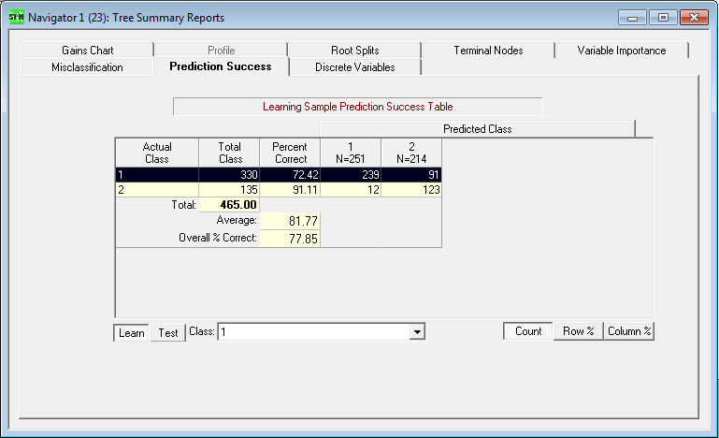
Evaluation
Prediction Success of the Model
The result shows that model has achieved average of
81.77% prediction success rate.

Slide 34

Deployment
This is the final phase of the
CRISP-DM process. Here we
will use the Model created and
perform deployment.
After evaluating the results obtained from the Model, in the previous phase, deployment would be executed on a small set of data to ensure success of Model.
Simple report of results will be provided and the results will be checked to verify success. The deliverables will be compared against the expected goal as discussed during the Business Understanding phase.
Finally the Model execution instructions will be provided to the Heath Care organization, who can now utilize this Model to help the doctors in their diagnoses, and identify patients suffering from Liver disease at an early stage. This will in turn increase the chances of patients survival.

Slide 35

Conclusion
The results show that the Model
achieved an average prediction
success rate of 82%. Which means
the Model has 82% chance of been
correct in identifying a Liver patient. Which is a fairly good performance.
Also we see that out of the 10 independent attributes, there are 5 attributes that play a major role in classifying the Liver patients, they are DB, TB, Alkphos, SGPT and SGOT.
Finally, the performance of the Model can be further optimized by using combination of different Algorithms. And can be used by the Health Care industry, and help doctors in diagnosis and patients in getting early treatment.

Slide 36

References
Discovering Knowledge in Data:
An Introduction to Data Mining,
By Daniel T. Larose
Lecture Notes and Slides
www.salford-systems.com
www.kdnuggets.com
“A Critical Comparative Study of Liver Patients from USA and INDIA: An Exploratory Analysis”, International Journal of Computer Science Issues, May 2012.
By Prof. Bendi, Prof. Surendra and Prof. Venkateswarlu.
“A Critical Study of Selected Classification Algorithms for Liver Disease Diagnosis”, International Journal of Database Management Systems (IJDMS), May 2011.
By Prof. Bendi, Prof. Surendra and Prof. Venkateswarlu.

Slide 37



